Slide 1


MH
to Year 3

Slide 2
Meet the Team
MH
Elder
Mrs Styles
Supported by: Mrs Pizzey
& Mrs Reeves
Birch
Mr Hill
Supported by: Mrs Luff & Miss Hopkins
Whitebeam​
Mrs Dickens
Supported by Mrs Glasscoe

Slide 3
Communications -
Good home-school communication is vital
MH
1.Your child
2. You
3. School
Classroom windows
Website
Weekly Newsletter
Arbor - letters
SMS
Email (8am-5pm), phone or preferably speak direct to your class teacher / make an appointment for a longer meeting if required

Slide 4
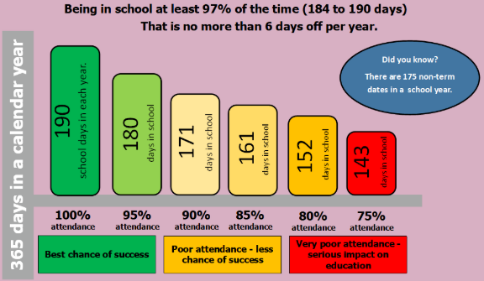
BS

Slide 5
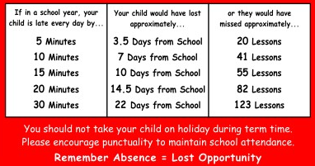
MH
At Woodlands Primary School, we have high expectations of attendance from all pupils. We strive for every child to be in school every day. Regular attendance is essential to ensure children reach their potential both academically and socially. Please make sure that your child is at school on time and is here every day, unless they are ill.

Slide 6
RD

Slide 7
Working together
Who do I go to?
The Class Teacher should be your first person to discuss any concerns, queries or matters pertaining to your child
The Phase Lead (Mrs Sheridan - 4 Walnut) can be brought in alongside the class teacher if further support is needed
After these have been explored, members of the Senior Leadership Team can be contacted for support:
Mrs Husband: Inclusion/SEND/Safeguarding
Mrs Adams: Behaviour incidents/Attendance
After these have been explored, or if it is related to academic progress, Mr Burns, deputy headteacher, can be contacted.
If there still remains concerns, issues or matters to discuss, Mrs Lonie, headteacher, can be contacted.
MH

Slide 8
Inspiring the Future Week
BS
Week beginning January 27th
Aims:
  Learn about jobs they might not have heard about before
  Learn they can do any job they want when they are older
  Understand that learning at school is important for their future job
  Understand there are lots of different jobs available when they grow up
Email Mr Burns (mburns@woodlands.kent.sch.uk if interested - providing details of job
All careers and jobs welcome!

Slide 9
Writing
BS
Cursive
Using pencil
Spelling is critical and we will be sending out homework each week.
Please support your child’s spelling practice
at home.
The children will be tested weekly.

Slide 10

Spelling homework
BS
*Your child will be given login details to take home in the coming weeks*
How to use Spelling Shed at home:
Access Spelling Shed by clicking EdShed or by scanning the QR code on your child’s login details.
Click ‘School username’ and enter the login details.
Click ‘Assignments’ and follow the on-screen instructions.
Once completed, your child’s class teacher will automatically receive feedback.
Assignments will be set on a Friday based on the spellings or rule your child is learning in school. They need to be completed by the following Friday when your child will be tested.
In addition to assignments set by the teacher, your child can practise their spellings with a range of activities and games, as well as grammar, punctuation and maths. Please encourage practice for at least 10 minutes a day, 5 times a week.
Use of Spelling Shed, also leads towards possible 50 house points for a house at the end of the week!

Slide 11

Reading
RD
Read aloud books - changed when an adult
has heard the whole book read aloud.
Focus on fluency and developing vocabulary.
Fluency: Children must be able to read 90-95%
of the words.
    Expression
    Automatic word recognition
    Rhythm and phrasing
    Smoothness
Star Books –10 high quality books recommended by us. Challenge to read at least 6 (one per term).
You can read Star Books and library books to your children.

Slide 12
Reading - Lexia
RD
The children will complete Lexia reading sessions 4x a week.
Helps with:
  Spelling Comprehension Grammar
  Children work through at their own pace
  Levelled up to work suitable for Year 6
  Activities specifically tailored to your child's needs
  The log in details will be available for you to use at home as the children will have them in their reading contact book. *UK version
  *Headphones plea

Slide 13
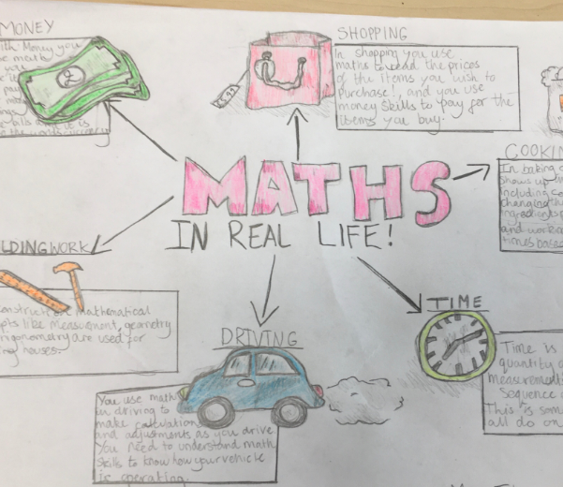
Maths
MH
Remember that maths is all around us...
Talk to your children positively about maths and look for patterns and numbers at home. Maths is a language we use to understand the world around us.
Talk about the pizza you have cut into thirds or quarters, look at the door numbers you walk past and estimate how many pasta shells are on the plate. Even when packing a suitcase you are thinking mathematically!

Slide 14
Maths- Fluency
MH
Please help your children to learn relevant number facts at home. They should learn the number facts so that they can recall them automatically, along with their fact families.
E.g.
5 x 4 = 20
4 x 5 = 20
20 ÷ 5 = 4
20 ÷ 4 = 5
Each year group will have a different focus.
As well as continuing to practise number facts within 20 (add/subtract) and the 2, 5 and 10 times tables, Year 3 focus on 3, 4 and 8 times tables.

Slide 15

Maths- Fluency
MH
Why is automatic recall of number facts so important for your child?
It builds strong foundations in maths, allowing them to solve more complex problems with greater ease.
It boosts confidence and reduces anxiety, increasing their engagement in maths.
Knowing number facts frees up mental energy for more advance problem solving, making learning more efficient.
Improves performance in maths assessments, leading to overall academic success and a positive attitude to learning.
At Woodlands, children are able to log in to the following:
(Login details will be put into homework books)

Slide 16
Maths- Fluency
MH
Helping pupils to become automatic with their recall is not usually a quick process and takes a lot of time and effort from both home and school, just like learning to read.
At woodlands we are looking for volunteers to help practise timestables on a regular basis. Please let Mrs Cameron know if you would be able to offer any regular time to help support pupils with this endeavour.
Lcameron@woodlands.kent.sch.uk
If you can offer regular support then we can help organise a DBS check.

Slide 17

BS
Reading our read aloud books daily.
Maths – every week linked to current learning set Friday due Wednesday (MPJ)
Spelling – every week linked to current
learning.
Times Tables
TTRock Stars – Sound check.

Slide 18
Curriculum
RD
History: Stone Age- Iron Age, Romans and Anglo-Saxons.
Geography: Europe, rivers, deserts.
Science: Rocks & soils, forces, animals including humans, plants and light & shadow.
Art: cave paintings, portraits and river projects.
DT: structures (castles), cooking (eating seasonally) and digital world (electronic charm)

Slide 19
P.E
BS
1st PE session is on Tuesday for everyone.
2nd PE session is on a Thursday for everyone.
It is an important curriculum subject
In winter, please provide track-suit and a hat – unless
the rain is torrential or the playground too icy we WILL be outside!
House colour t-shirt, dark shorts, plain black trainers.
Earrings – not allowed. Take out before they come to school please. Plan ahead and pierce in the summer holiday.

Slide 20
P.E - swimming
MH
Year 3 will be swimming in Terms 3, 4, 5 and 6.
Swimming is on a rota. We will inform you nearer the time which class is going at what time.
The last class will be back on site as close to 3:15 as possible. We may be a little late.
Children need a swimming costume/trunks, a towel and a swimming hat. Children need to wear goggles. No earrings – please!
Cost is yet to be confirmed but you will receive information about this in due course.

Slide 21
Trips
MH
Mr Berry visited us for Rock day last week!
A visit to Lullingstone in Term 5 to supplement our Rivers topic.

Slide 22
Residential
MH
In Year 6 your children will go on a 5 day residential trip.
You will shortly be receiving information on this.
We offer the opportunity to pay this in instalments from Year 3 onwards.

Slide 23
Pupil Premium
RD
If your child has ever had Free School Meals the school qualifies for a £1300 Pupil Premium grant to assist their learning and development.
If, as a parent, you are in the armed forces there is also a grant to the school in support of your child.
If your child qualifies as being in the care of the local authority – the school will also be entitled to a amount to enrich your child’s education.
Please speak to the office or Inclusion Team if you feel your child should qualify for any of these grants – they are an enormous help in ensuring the school can best help your child.

Slide 24
Behaviour and rewards
BS
Endeavour Awards
  Weekly award based on demonstrating positive learning attitude
Positive Postcards
  Demonstrating values in one or more of the following values: respect, resilience, responsibility, care, creativity or community
Termly Woodlands Ambassador Awards
  Awarded for someone that continuously demonstrates the values expected of a Woodlands learner

Slide 25
Smartphone Free School
MH
At Woodlands, we are committed to supporting children’s wellbeing and development — both in and out of the classroom. With this in mind, we want to share important information with you about smartphone use among primary-aged children and the steps we will be taking as a school from September 2025.
We’ve done our own research – and the evidence is compelling. We’re also seeing the real-world effects of smartphones in school. That’s why, together with Woodlands parents and other local schools, we’re working in partnership and have met with our local MP to explore strategies for protecting children’s digital wellbeing across Tonbridge.
Changes from September 2025:
Year 5 and below: children will not be permitted to bring smartphones to school. If a phone is needed for contact, it must be a basic or non-smart device.
From September 2026, Woodlands will be a smartphone free school for all children.

Slide 26
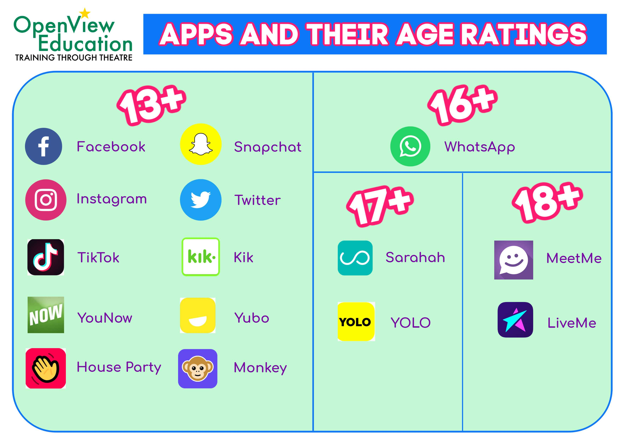
Social Media and Internet Safety
MH

Slide 27


Slide 28
Term 5 - Relationships
MH
Lesson 1 Exploring male and female stereotypes Discussions will focus on fairness, tradition and habit. We think about roles in the workplace and at home and reflect briefly on how media and film present these roles. | Lesson 2 Exploring friendships Children will have to solve a series of friendship puzzles and role-play resolving friendship conflicts.

Slide 29
Term 5 - Relationships
MH
Lesson 3 Online safety Children will think about gaming apps. They will consider if all reviews are trustworthy and learn to be more discerning when choosing apps. They will also think about in-app messaging and what constitutes cyberbullying. | Lesson 4 Being a global citizen 1 We will explore goods and products from other countries. Children will consider where our goods come from and if there are equal benefits to both countries. We will use images to explore the lives of the people who are growing/making these goods.

Slide 30
Term 5 - Relationships
MH
Lesson 5 Being a global citizen 2 Children will think about their rights. Do they have any? What are they? The UN Convention on the Rights of a Child will be shared with them. Children will be given scenarios that prompt discussion about basic needs. Children will discuss deprivation, fostering and adoption. | Lesson 6 Celebrating relationships Children will bring together all the learning from previous weeks and think closely about the special people in our lives.

Slide 31
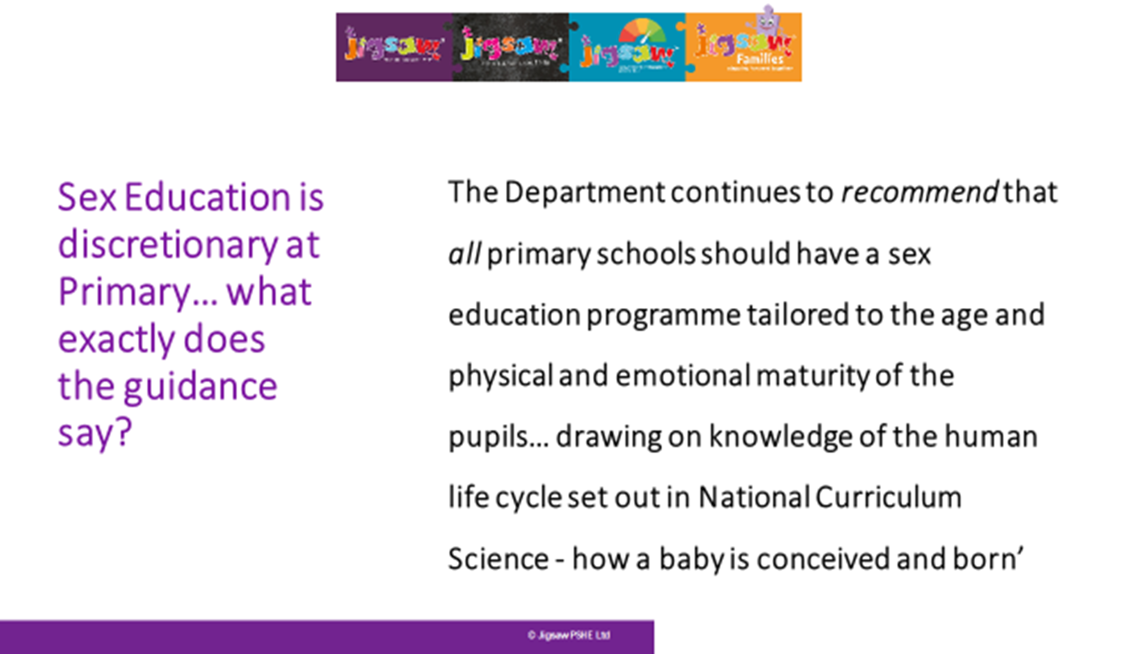
Changing me – 6 lessons
MH

Slide 32
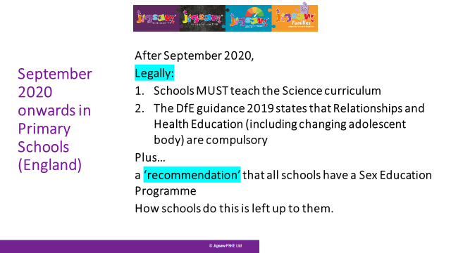
RD

Slide 33
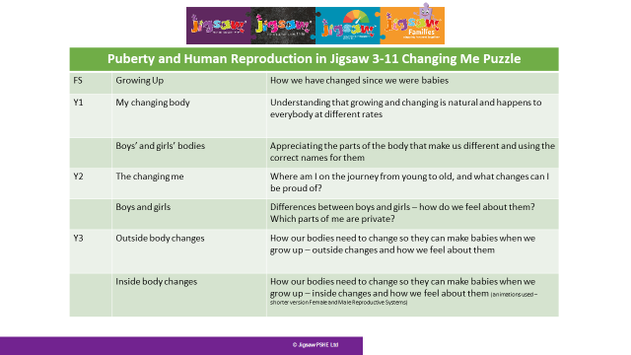
RD
Puberty and Human Reproduction in Jigsaw 3-11 Changing Me Puzzle
FS | Growing Up | How we have changed since we were babies
Y1 | My changing body | Understanding that growing and changing is natural and happens to everybody at different rates
 | Boys’ and girls’ bodies | Appreciating the parts of the body that make us different and using the correct names for them
Y2 | The changing me | Where am I on the journey from young to old, and what changes can I be proud of?
 | Boys and girls | Differences between boys and girls – how do we feel about them? Which parts of me are private?
Y3 | Outside body changes | How our bodies need to change so they can make babies when we grow up – outside changes and how we feel about them
 | Inside body changes | How our bodies need to change so they can make babies when we grow up – inside changes and how we feel about them (animations used – shorter version Female and Male Reproductive Systems)
ALL THIS FALLS WITHIN THE STATUTORY HEALTH EDUCATION GUIDANCE…changing adolescent body so is compulsory.

Slide 34
Term 6 – Changing me
RD
Lesson 1 How babies grow Children will consider how it feels to have a new baby in the family. They will reflect on what a baby needs adult support for and think about the roles of parents. They will draw a sequence to show changes that happen for a baby from birth to being fully grown. | Lesson 2 Babies Children work collaboratively to decide what babies need to grow and survive. They will discuss the importance of love and affection. They look at images that show how a baby grows inside its mother. Vocabulary used will include womb, uterus, ovum. We do not discuss ‘how the baby got there’.

Slide 35
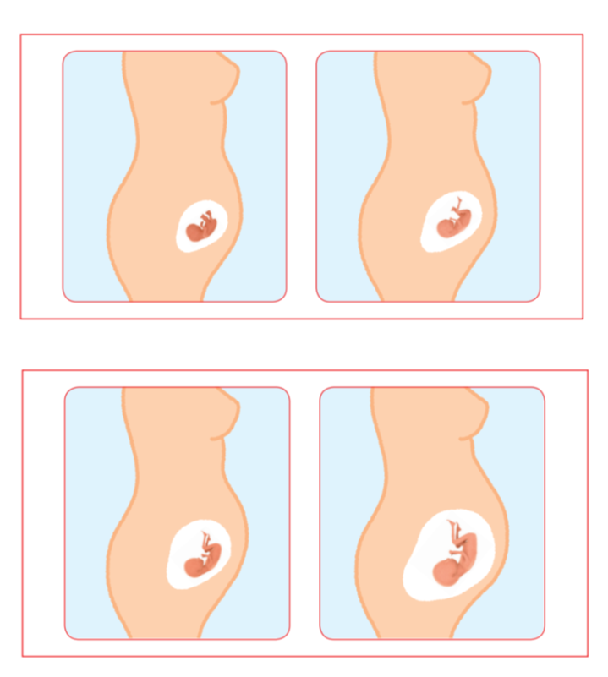
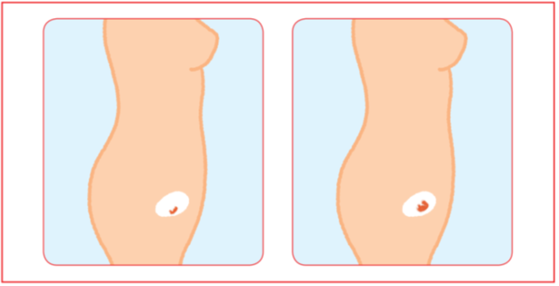
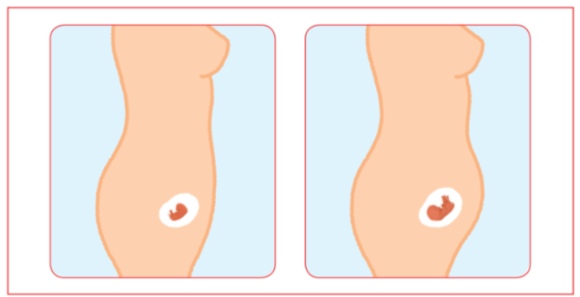
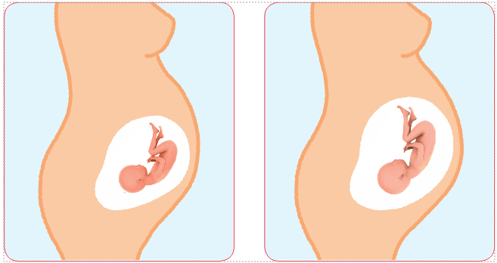
Lesson 2 resource
RD

Slide 36
Term 6 – Changing me
BS
Lesson 3 Outside body changes Children will discuss any changes that have happened in their lives. We will acknowledge that change can be exciting but also, at times, difficult. Children will be sensitively introduced to the concept of puberty and that it refers to a collection of changes that will gradually change their bodies from a child’s body into an adult body. | Lesson 4 Inside body changes We will think about how new life starts and reflect back to lesson 3 to explain that puberty is about getting our bodies ready for making and having babies when we are adults. We will discuss the changes to the male and female reproductive system. Key vocabulary: testicles, sperm, penis, ovaries, egg, ovum, womb, vagina and period. Children have an opportunity to ask a question in confidence using a post-it.

Slide 37
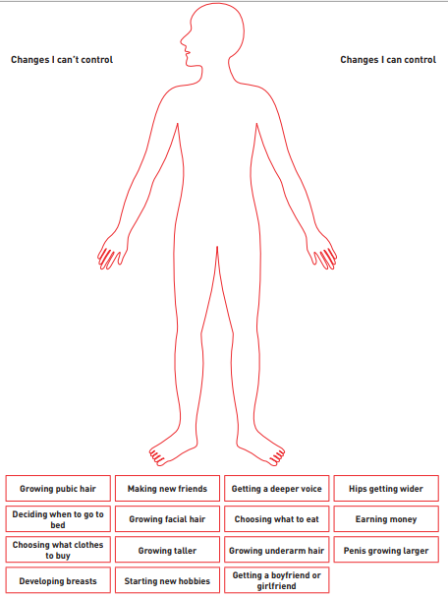
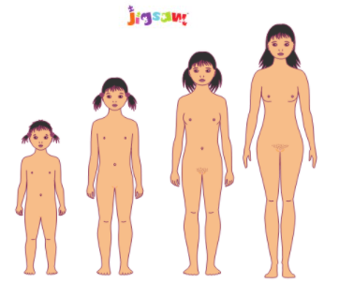
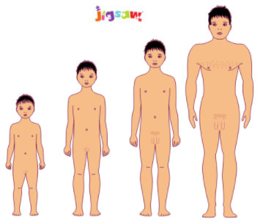
Lesson 3 resources
BS

Slide 38
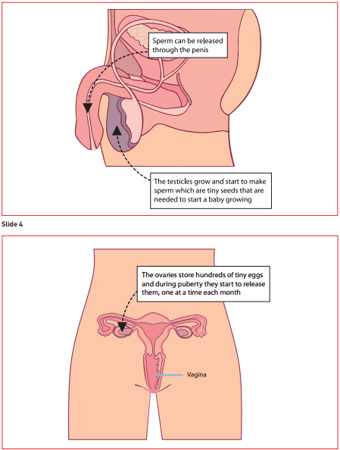
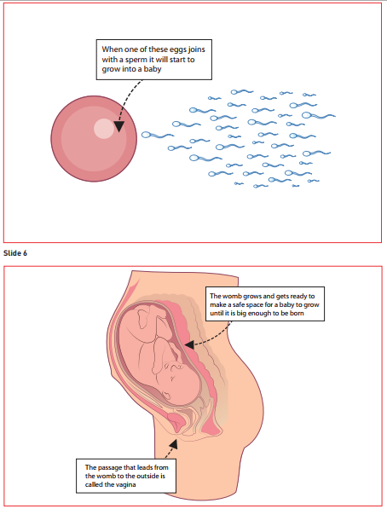
Lesson 4 resources
BS

Slide 39
Term 6 – Changing me
BS
Lesson 5 Family stereotypes We will revisit our discussions about stereotypes and think more on how these ideas are developed. We will explore the idea of having our opinions questioned and how it feels to change our thoughts or ideas about something. | Lesson 6 Looking ahead The children will reflect on the learning from this unit of work and make a ribbon mobile to show their understanding and have an opportunity to ask questions. Children will think about their transition to Year 4 and what they are looking forward to.

Slide 40
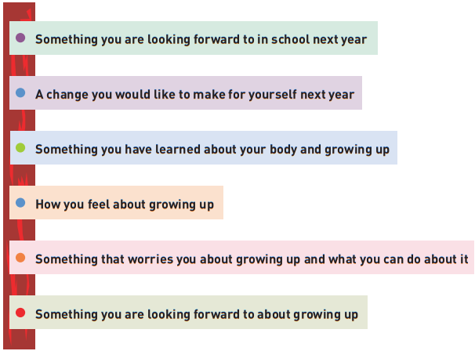
Lesson 6 resource
BS

Slide 41

Any Questions ?
MH

