Slide 1
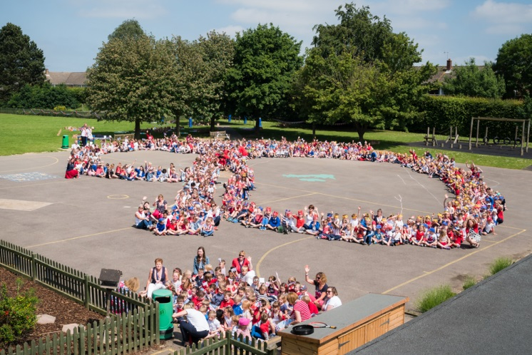
Woodlands Primary School
Year R Parent Meeting
2026

Slide 2
Who’s Who?
Headteacher: Mrs Vicki Lonie
Deputy Headteacher: Mr Mark Burns
SENCo: Lucy Husband
Early Years Leaders:
Mrs Antoinette Gosling
Mrs Julia Howe
Office Manager: Mrs Wilson
(office@woodlands.kent.sch.uk)
Pastoral Support: Jo Stone
(jstone@woodlands.kent.sch.uk)

Slide 3

Our top ten tips for a great start at school….. (pg 16 in PTA booklet)
To be able to:
dress and undress independently
toilet independently and wash and dry hands
eat using a knife, fork and spoon
understand the importance of being kind and sharing
play with concentration
listen and follow instructions (more than one)
enjoy stories and rhymes

Slide 4
Getting started…
Induction arrangements are planned to ensure that all children settle well into the Reception class routines.
Our plan for this year is detailed below:
Tuesday 1st September and Wednesday 2nd September
Children will attend for either the morning or afternoon session. Timings for your child can be found in the letter informing you who your child’s class teacher will be.
Thursday 3rd and Friday 4th September
All children will attend for the morning session only. The sessions starts at 9am to 11:45am.
Please collect your child from school at 11: 45 am.
Monday 7th to Wednesday 9th September
All children will attend for the morning session at 8.45am (doors open at 8.40am) and stay at school for lunch.
Please collect your child at 1:00pm.
From Thursday 10th September
All children will attend a full day, from 8:45am — 3:15pm.
The classroom doors open every morning at 8.40 am.

Slide 5
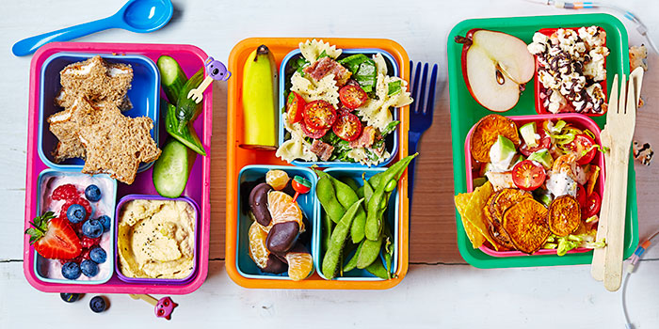
Lunchtimes
School Dinners
Healthy Packed Lunch
  Small portions
  Sandwich, pasta, fruit, water or milk, yoghurt (check the sugar content)
  https://www.bbcgoodfood.com/howto/guide/school-packed-lunch-inspiration
  No sweets, chocolate, sweetened or fizzy drinks

Slide 6

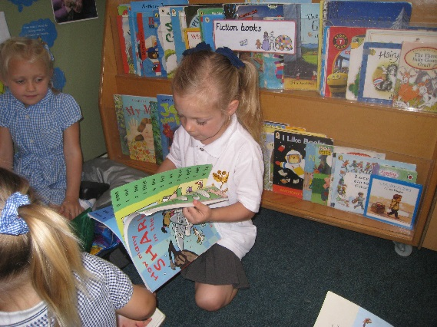
Reading with your child
Enjoyment is key.
Read lots of different books with your child (we can lend these to you – please ask).
Talk about words that rhyme.
Once your child starts to read:
    help your child to decode simple, phonetic words.
    read words for them, if they are struggling.
Some parents have difficulties with reading – please tell us – this is nothing to be ashamed of. We can help.

Slide 7
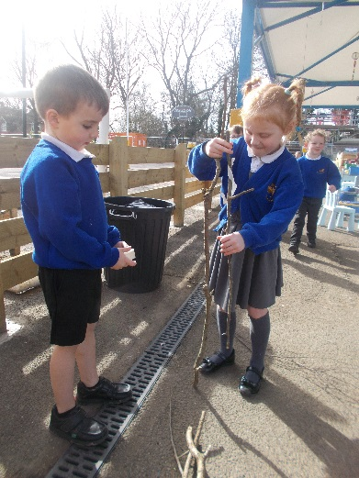
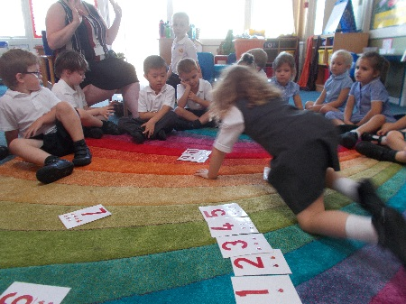
Counting with your child
Maths should be fun.
Always put it in an everyday context.
Count stairs, steps, trees, tins, pasta shapes! Add one more, take one a way. Sing a rhyme.
Once confident, count in pairs or use bigger numbers.
Don’t be frightened of using the real words. Use half and quarter correctly – share sweets! Half each – one for you, one for me, etc.
Measure for real – cooking, craft.
Shapes are all around us.

Slide 8
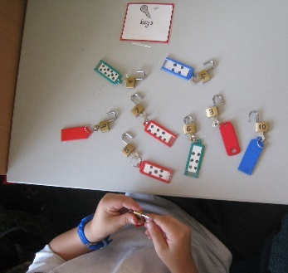

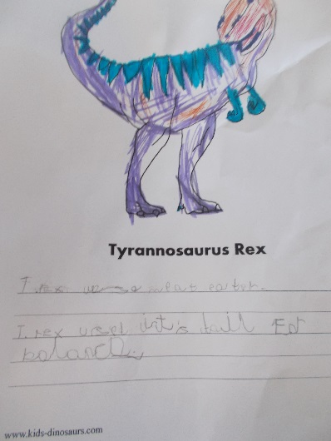
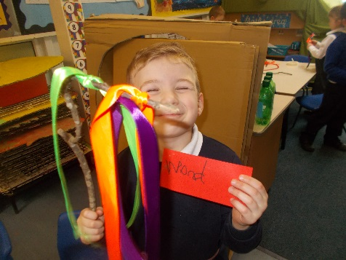
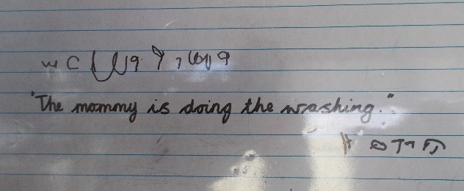
Writing with your child
Don’t panic!
Get the basics right – holding a pencil – the importance of our muscles…fine motor skills.
Drawing in the air.
Pretend writing – this is great! Play schools, shops, make lists.
Cursive handwriting

Slide 9
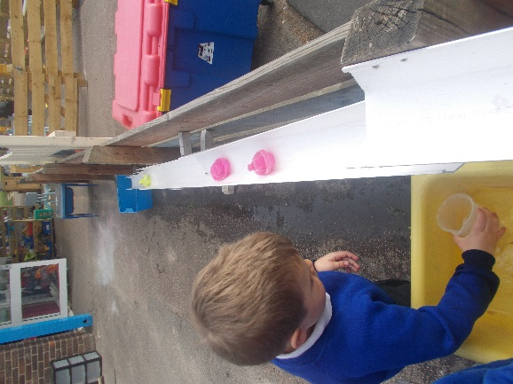
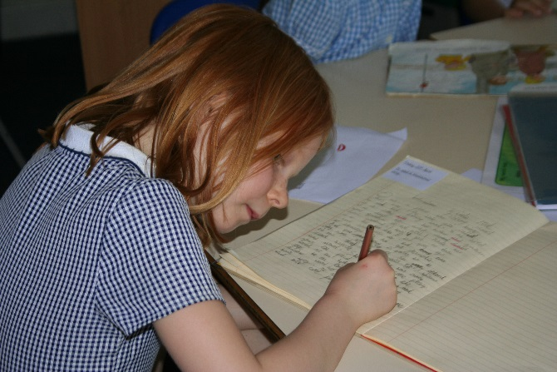
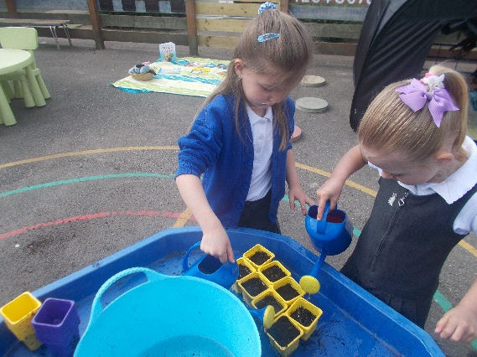
Powerful learning tools
Going outside! A real education.
Talking, talking, talking.
Letting your child do the hard work (with encouragement!)
Risk – opportunities to learn to assess it
Resilience – not everything goes right all the time – and it shouldn’t. Children need to learn this.
Growth Mindset – I can’t do it yet!

Slide 10
Where can I find information?
Website: www.woodlands.kent.sch.uk
School newsletter – sent home weekly
What we are learning – sent home weekly
Termly curriculum letters
Emails – Arbor
Classroom Door

Slide 11
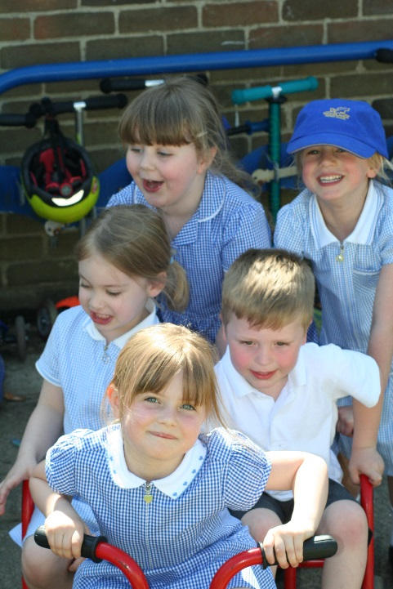
What is Pupil Premium Funding?
The pupil premium is additional funding for publicly funded schools in England to raise the attainment of disadvantaged pupils and close the gap between them and their peers

Slide 12
Why are we always talking about attendance?
Education is like a jigsaw puzzle – without all the pieces your child may never have the whole picture.
Is 90% enough?
95% = 10 days missed in one year
90% = 20 days in one year
85% = 30 days in one year
If your child attends for only 90% of the time they will miss 23 weeks – over half a school year

Slide 13
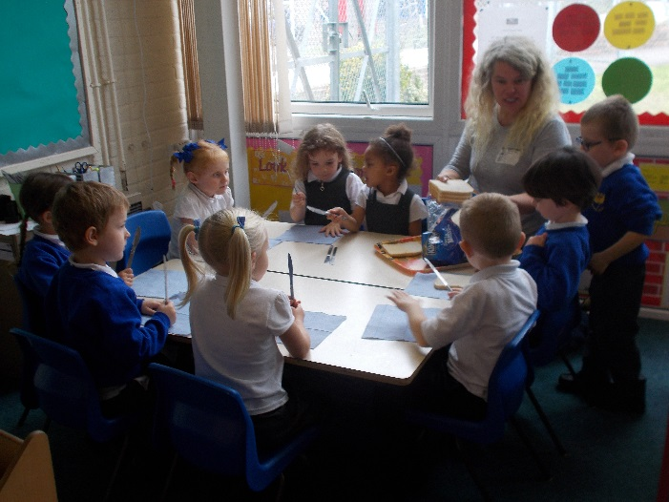
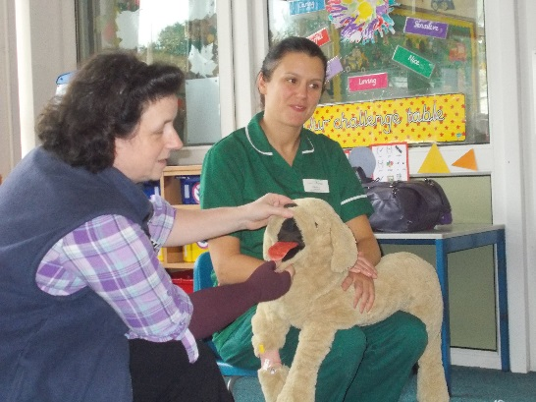
How can I be involved?
The best kind of involvement is to support your child with their learning!
Volunteer (DBS)
PTA
Governors

Slide 14
What do I do if I am worried?
Class Teacher
Early Years Leader
SENCo
Pastoral Lead
Headteachers
It’s good to talk!

Slide 15

Help for Working Parents
Electronic Communication
Before and After School Clubs - contact@rainbowschoolclubs.com

Slide 16
Getting to School
Park and walk – please be mindful of where you park
Walk
Cycle/scooter
No parking on site unless with a disability badge – please let us know

Slide 17
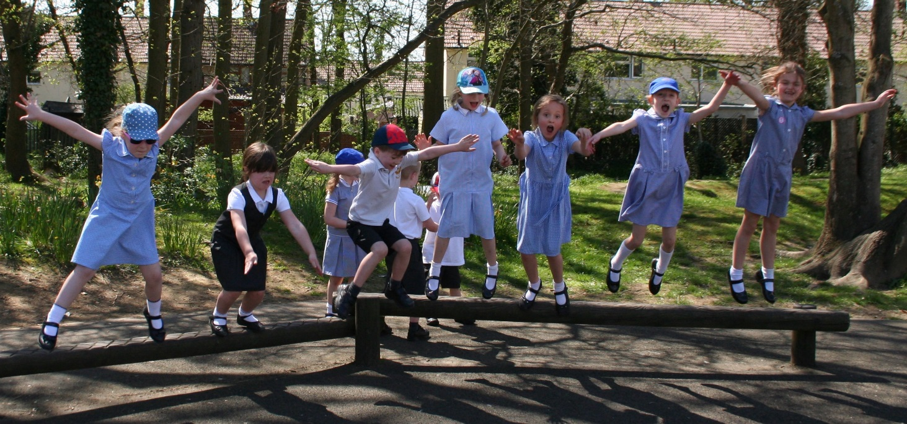
Thank you
The journey begins……

