Slide 1


to
Year 3

Slide 2
Meet the Team...
ES
3 Whitebeam
3 Birch
3 Elder
Mrs Keene
Mr Hill
Mrs Sheridan
Teaching Assistants:
Miss Glascoe
Miss Mitchell (M-Th) and Mrs Hood (F)

Slide 3
Transition from Year 2 to Year 3
MH
Year 3 marks an important step in children's learning journey as they move into Key Stage 2.
We focus on developing
independence
resilience
responsibility

Slide 4

Reading
JK
Read Aloud Books
Books are changed once an adult has heard the child read
the entire book aloud. IT IS VITAL THAT YOUR CHILD READS EVERY DAY.
Why read with your child?
  Research from Oxford University Press reveals that “Children who read outside of class are 13 times more likely to read above the expected level for their age.”
Your child should read with fluency and accuracy.
Fluency means children can read 90-95% of the words accurately and demonstrate:
  Expression
  Automatic word recognition
  Rhythm and phrasing
  Smoothness
.

Slide 5

STAR Books
You can read both STAR Books and library books to your child at home
JK
What are STAR books?
They are a varied selection of engaging books for every Year 3 child. They range from fiction to non-fiction.
When your child has read a STAR book, they will have brief chat with their class teacher about the book. Then, they will receive a star for the book they have read.
If they read 6 books, they will receive a bronze certificate.
If they read 9 books, they will receive a silver certificate.
If they read 12 books, they will receive a gold certificate.

Slide 6
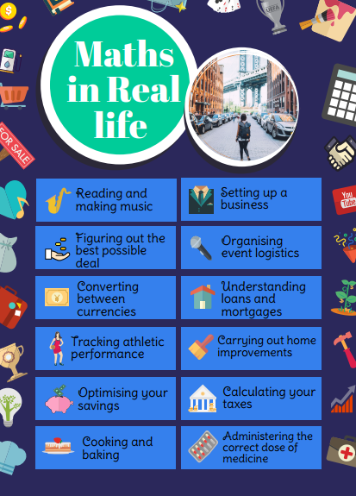
Maths
MH
Maths is a language we use to understand the world around us.
Talk to your children positively about maths and look for patterns and numbers at home
Talk about the pizza you have cut into quarters or eighths, look at the door numbers you walk past and estimate how many pasta shells are on the plate. Even when packing a suitcase you are thinking mathematically!

Slide 7

Maths
MH
Why is automatic recall of number facts so important for your child?
It builds strong foundations in maths, allowing them to solve more complex problems with greater ease.
It boosts confidence and reduces anxiety, increasing their engagement in maths.
Knowing number facts frees up mental energy for more advance problem solving, making learning more efficient.
Improves performance in maths assessments, leading to overall academic success and a positive attitude to learning.
At Woodlands, children are able to log in to TTRS.
( Login details will be put into homework books)

Slide 8
Maths
MH
Please help your children to consolidate and practise relevant number facts at home:
adding and subtracting within 10 and 20: this is vital!
multiplication facts and fact families. For example,
5 x 4 = 20
4 x 5 = 20
20 ÷ 5 = 4
20 ÷ 4 = 5
As well as continuing to practise number facts within 20 (add/subtract) and the 2, 5 and 10 times tables, Year 3 focus on learning the 3, 4 and 8 times tables.

Slide 9


Maths Homework
We can provide you with a maths homework book which your children will use each week.
Children can also be provided with a separate purple book to copy answers into as they are not allowed to write in the school – issued book.
Some parents choose to purchase their own copy so that the answers can be directly written into the book rather than writing in separate purple exercise book. If you feel your child will benefit from having their own copy to write answers directly into, they can be purchased from Amazon for approximately £5.
If you are purchasing your own copy, please advise your teacher before Friday 18th September
SCHOOL- ISSUED BOOKS MUST BE RETURNED AT THE END OF THE YEAR IN USABLE CONDITION PLEASE.

Slide 10
Times Tables Homework
To help children develop fluency and confidence with their times tables, each child will be given a weekly times table sheet that is carefully matched to their current stage of learning.
At school, children will have 5 minutes to complete their sheet independently. This completed sheet will then be sent home every Friday so that you can see how they got on. On the reverse is an identical blank copy for your child to practise with you at home.
Once a child can complete their times table sheet accurately with no errors on 3 consecutive occasions, they will move on to a new set of questions and begin the process again. This allows every child to progress at an appropriate pace, building secure knowledge and rapid recall of multiplication facts.

Slide 11
Handwriting
JK
In Year 3, we build on the foundations established in Key Stage 1 by helping children develop neat, fluent and legible handwriting. This is important so they can communicate their ideas clearly and confidently.
How do we support handwriting development?
Regular handwriting practice
Explicit teaching of correct letter formation
Reinforcement of correct pencil grip and posture
Focus on consistent letter size and positioning
Writing in pencil to develop control and fluency
Encouraging high standards of presentation across all subjects

Slide 12
Spelling
JK
The spelling scheme used in school starts from reception and progresses up to year 6.
At the start of each term, children will be bringing home a list of red and orange words for them to learn at home. These will be taught in school alongside a weekly spelling rule.
The words to learn have been stuck in their blue home reading record book for reference. The children will be quizzed on them weekly.
Red word examples: said, what, where, because etc. Words that don’t follow a rule.
Orange words will be curriculum words.

Slide 13

What it Is? A computer-based reading program used in school and at home to help with reading confidence and fluency.
LEXIA automatically adjusts to your child's exact reading level,
  letting them learn at their own comfortable pace.
Games and activities that build essential skills, including phonics, vocabulary, spelling, and reading comprehension.
LEXIA checks your child's progress quietly in the background, showing us exactly where they need extra help.
We will be sending home a log in for your child to practise at home.
JK

Slide 14

MH
Reading our read aloud books daily.
Maths – every week linked to current learning set Friday due Wednesday
Spelling – every week linked to current
learning.
Times Tables
TTRock Stars – Sound check.

Slide 15
Year 3 Curriculum
MH
History: Stone Age- Iron Age, Romans and Anglo-Saxons.
Geography: Europe, rivers, deserts
Science: Rocks & soils, forces, animals including humans, plants and light & shadow.
Art: cave paintings, portraits and river projects.
DT: structures (castles), cooking (eating seasonally) and E-Charms)

Slide 16
PE
JK
1st PE session is on Tuesday.
2nd PE session is on a Thursday.
In winter, please provide track-suit and a hat – unless the rain is torrential or the playground too icy we WILL be outside!
House colour t-shirt, dark shorts, plain black trainers.
Earrings – not allowed. Take out before they come to school please. Plan ahead and pierce in the summer holiday.

Slide 17
PE - Swimming
MH
Year 3 will be swimming in Terms 3, 4, 5 and 6 at Tonbridge Swimming Pool and taught by qualified swimming instructors.
Swimming is on a rota. We will inform you nearer the time which class is going at what time.
The last class will be back on site as close to 3:15 as possible. We may be a little late.
Children need a swimming costume/trunks, a towel and a swimming hat. Children need to wear goggles. No earrings – please!
Cost is yet to be confirmed but you will receive information about this in due course.

Slide 18
Introducing a new initiative…
Let Grow: Developing Independence
Helping children become more confident, resilient and responsible
Optional
Each month...
A new independence challenge is shared with families
Children choose a safe, age-appropriate activity
As parents encourage... then step back
Children reflect on what they learned
JK
The goal isn't to do something difficult. The goal is to build confidence and independence through real-life experiences.
Examples:
🍳 Make your own breakfast
🎒 Pack your school bag independently
🛒 Buy something in a local shop
⭐ Try something new
Notes:
"You may have seen information about Let Grow in the recent communication, on our website or in the updated homework policy. Once a month, we'll share an optional challenge linked to developing independence. Children choose an activity with their family, have a go themselves, and then reflect on what they learned. It's not about getting things perfect; it's about helping children discover just how capable they are."

Slide 19
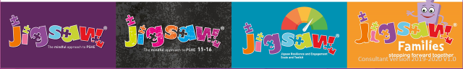
Relationships, Sex & Health Education (RSHE)
From September 2026

Slide 20
Term 5 - Relationships
Lesson 1 Exploring male and female stereotypes Discussions will focus on fairness, tradition and habit. We think about roles in the workplace and at home and reflect briefly on how media and film present these roles. | Lesson 2 Exploring friendships Children will have to solve a series of friendship puzzles and role-play resolving friendship conflicts.

Slide 21
Term 5 - Relationships
Lesson 3 Online safety Children will think about gaming apps. They will consider if all reviews are trustworthy and learn to be more discerning when choosing apps. They will also think about in-app messaging and what constitutes cyberbullying. | Lesson 4 Being a global citizen 1 We will explore goods and products from other countries. Children will consider where our goods come from and if there are equal benefits to both countries. We will use images to explore the lives of the people who are growing/making these goods.

Slide 22
Term 5 - Relationships
Lesson 5 Being a global citizen 2 Children will think about their rights. Do they have any? What are they? The UN Convention on the Rights of a Child will be shared with them. Children will be given scenarios that prompt discussion about basic needs. Children will discuss deprivation, fostering and adoption. | Lesson 6 Celebrating relationships Children will bring together all the learning from previous weeks and think closely about the special people in our lives.

Slide 23
Term 6 – Changing me
Lesson 1 How babies grow Children will consider how it feels to have a new baby in the family. They will reflect on what a baby needs adult support for and think about the roles of parents. They will draw a sequence to show changes that happen for a baby from birth to being fully grown. | Lesson 2 Outside body changes Children will discuss any changes that have happened in their lives. We will acknowledge that change can be exciting but also, at times, difficult. Children will be sensitively introduced to the concept of puberty and that it refers to a collection of changes that will gradually change their bodies from a child’s body into an adult body.

Slide 24
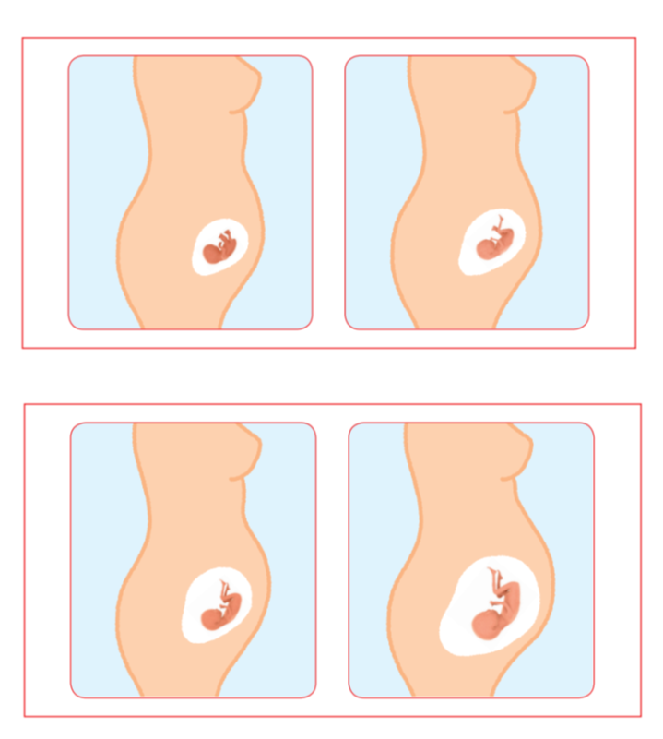
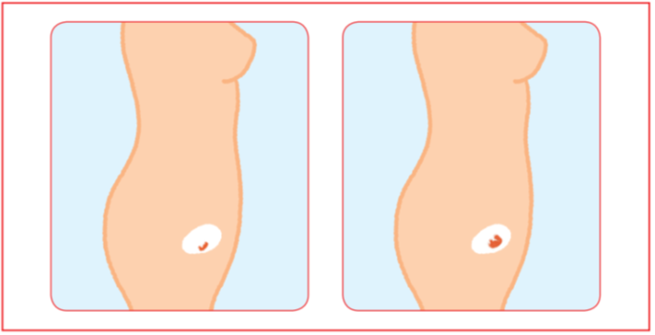
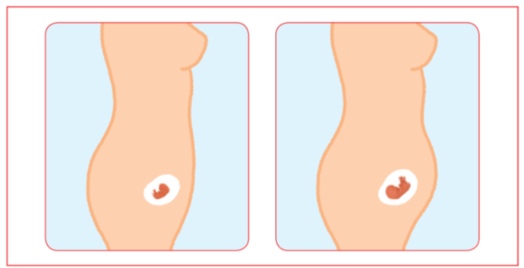
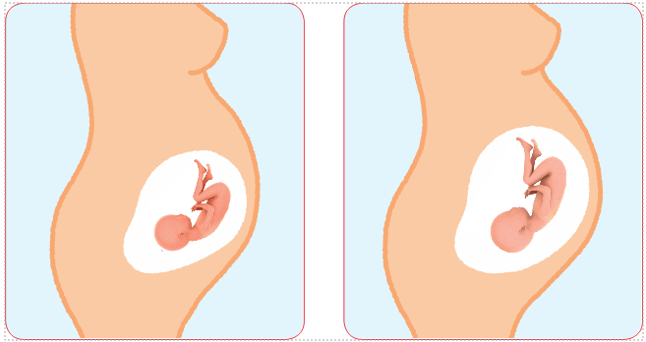
Lesson 2 resource

Slide 25
Term 6 – Changing me
Lesson 3 Inside body changes We will think about how new life starts and reflect back to lesson 3 to explain that puberty is about getting our bodies ready for making and having babies when we are adults. We will discuss the changes to the male and female reproductive system. Key vocabulary: testicles, sperm, penis, ovaries, egg, ovum, womb, vagina and period. Children have an opportunity to ask a question in confidence using a post-it. | Lesson 4 Keeping ourselves clean In this lesson, we will learn that as boys’ and girls’ bodies change during puberty, it is important to think about keeping clean and healthy. They will explore simple ways of maintaining good personal hygiene and will understand how these habits can help keep them healthy and protect them from some infections. The lesson will encourage positive self-care routines and support their understanding of growing and changing bodies

Slide 26
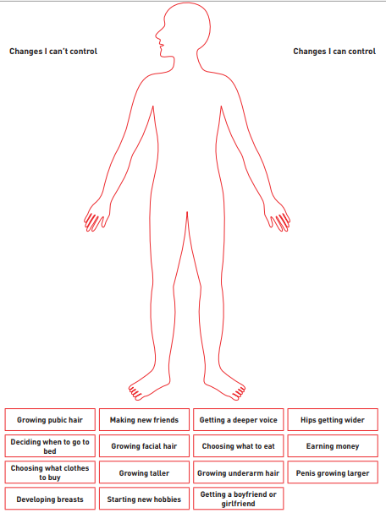
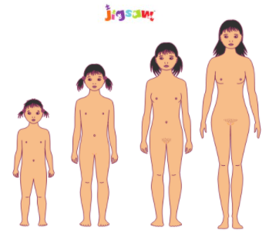
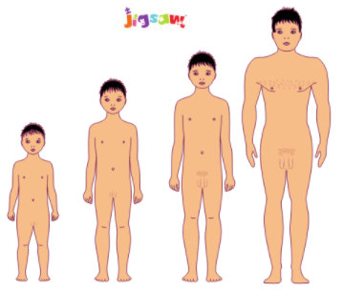
Lesson 3 resources

Slide 27
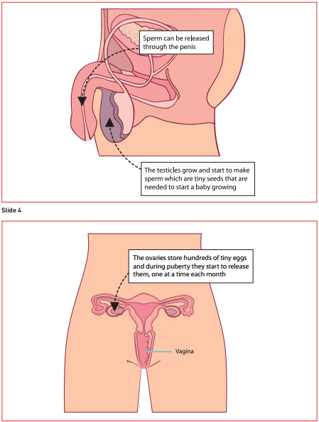
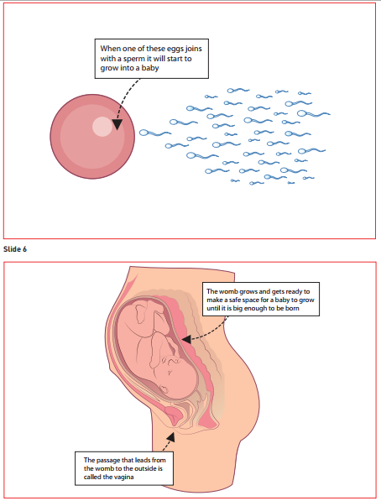
Lesson 4 resources

Slide 28
Term 6 – Changing me
Lesson 5 Family stereotypes We will revisit our discussions about stereotypes and think more on how these ideas are developed. We will explore the idea of having our opinions questioned and how it feels to change our thoughts or ideas about something. | Lesson 6 Looking ahead The children will reflect on the learning from this unit of work and make a ribbon mobile to show their understanding and have an opportunity to ask questions. Children will think about their transition to Year 4 and what they are looking forwa to.

Slide 29
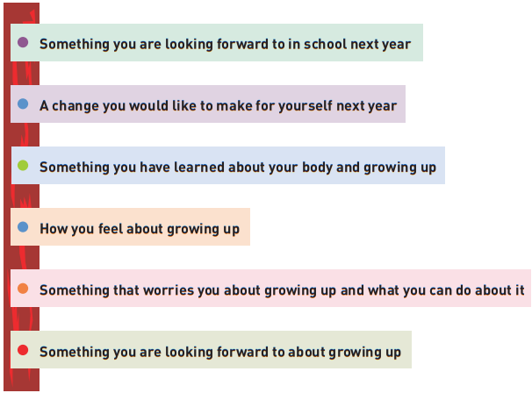
Lesson 6

Slide 30
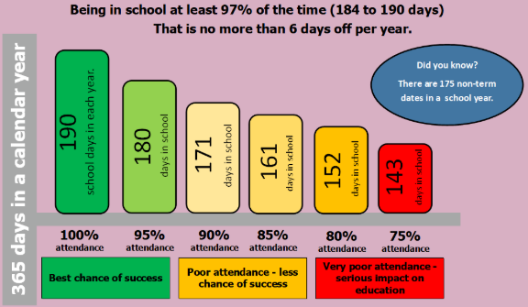

Slide 31
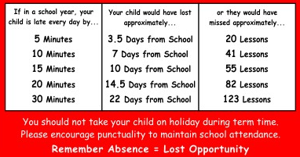
At Woodlands Primary School, we have high expectations of attendance from all pupils. We strive for every child to be in school every day. Regular attendance is essential to ensure children reach their potential both academically and socially. Please make sure that your child is at school on time and is here every day, unless they are ill.

Slide 32
What YOU must do:
• Try to telephone the school before 8.30am each day of your child’s absence or email the school office on office@woodlands.kent.sch.uk
• Tell the school in advance, of any medical appointments (try to make these out of school hours when you can)
• If you are not sure whether your child is well enough to attend school, send them in anyway as they often perk up on arrival. Read the NHS guidance, ‘Is my child too ill for school?’
• Have a back-up plan for if your child for transport: call on a family member, neighbour or friend.
• If you and your child are experiencing difficulties with school attendance, then talk to us as a first step so we can help!
• If you request a term-time absence for holiday, we will ask to meet with you in advance.
What WE will do:
• Check your child’s attendance every day
• Phone home to discuss your child’s attendance with you
• Invite you into school for attendance meetings if we are concerned
• Work with you to put in place interventions to improve and support attendance
• If we cannot establish a reason for absence, then we may make a welfare home visit.

Slide 33
Communication
Good home-school communication is vital
We will continue to communicate in a number of ways...
Messages on classroom windows
Website
Weekly newsletter
Via Arbor

Slide 34
Communication
Class teachers are your first port of call.
Day-to-day communication
You are welcome to speak briefly with teachers at the classroom door for quick queries.
Arranging discussions
If you wish to discuss a more complex matter or are unable to access the above:
Please fill out a form on our website page under the ‘Parent’ tab to request a phone call, brief email response or meeting with the teacher.
These will be arranged at a mutually convenient time, recognising that teachers are engaged in teaching and school responsibilities throughout each day.

Slide 35
Who to contact:
1. Class teacher
2. Phase Leader
3. Senior Leaders
Amy Adams
Behaviour/Attendance
Lucy Husband
Safeguarding/SEND/
Inclusion
Mark Burns
Learning/Ongoing concerns
4. Headteacher

Slide 36
Ongoing communication
We will continue to provide:
Three parent consultation meetings each year
Regular updates on academic progress
End-of-year reports
SEND and attendance meetings where appropriate
Teacher-instigated phone calls or meetings for extraoinary reasons
Emails home via Arbor to share information (these will be one-way but parents can request a meeting/call to discuss further via the on-line form)
For most families, these opportunities will provide sufficient communication regarding your child’s progress and wellbeing. If, however, further communication is required, please see our webpage under ‘Parents’.

Slide 37
SEND
A huge rise in SEND nationally means we are having to adapt practice as autism, ADHD and similar become typical.
Very few children in mainstream schools require 1-1 support and most children’s needs can be met in mainstream.
Our universal offer includes, first and foremost, excellent teaching, adapting to the needs of the children with resources such as Clicker 8, overlays, wobble cushions – not separate ‘add-ons’.
‘Brain breaks’ will be provided as part of daily practice not as separate provision for individuals.
We want our children to feel like they belong, to be successful and to become independent learners. We need to prepare children for the reality of secondary school and beyond.
How do we achieve this?

Slide 38
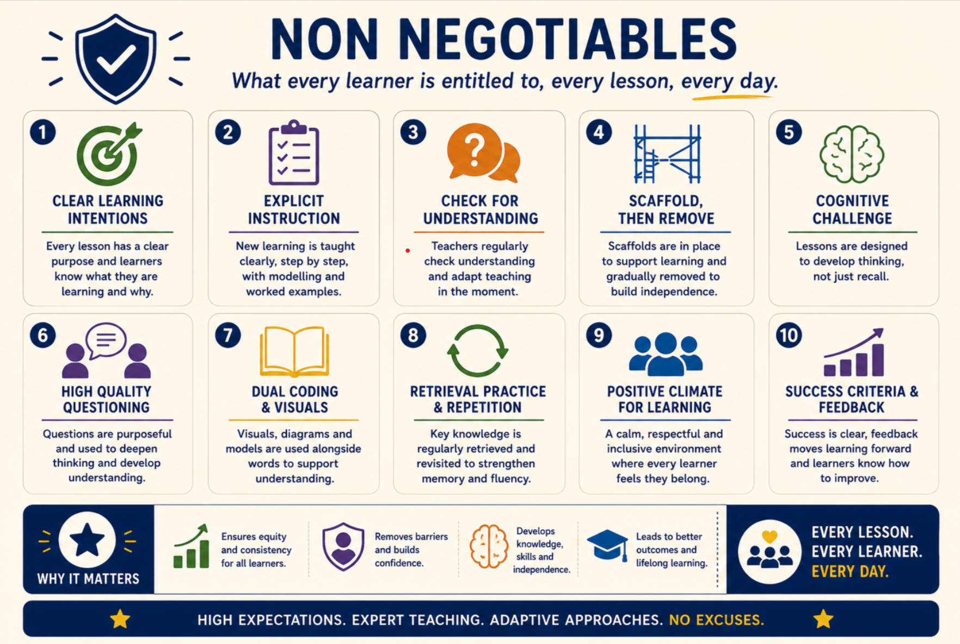

Slide 39
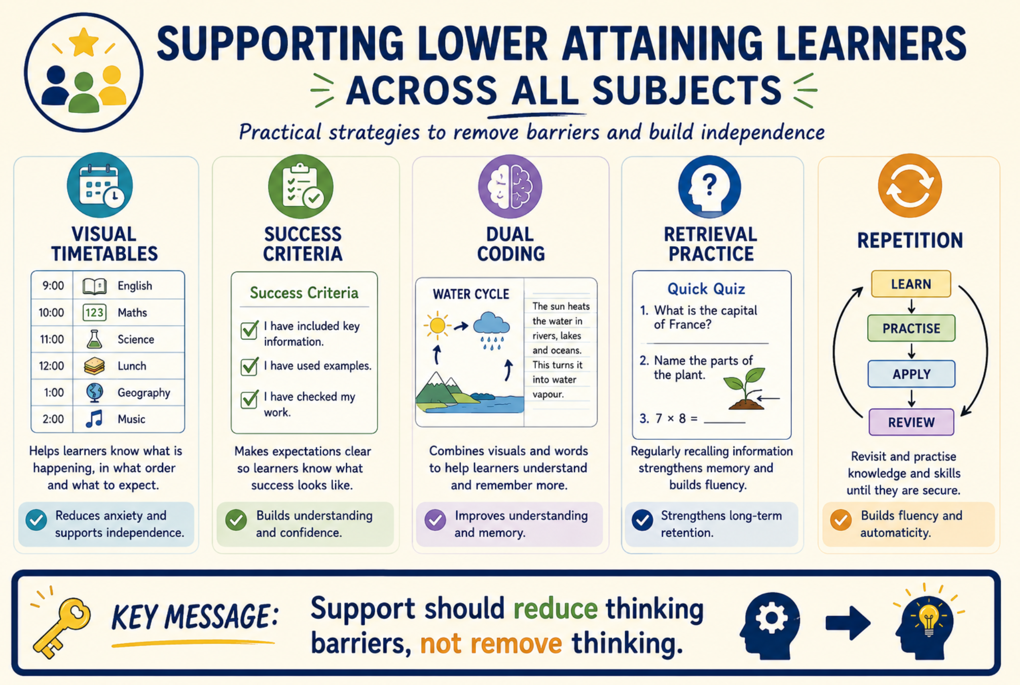

Slide 40
Typical childhood experiences…
Your child will find challenges along the way:
  Friendship issues
  Unkindness
  Difficulty telling the truth
  Understanding we are all different
We can help them together!
These are not usually ‘serious safeguarding issues’ – schools are filled with children who make mistakes and have to learn how to rectify and learn from them.
Trust us to manage these situations effectively – it’s what we do.

Slide 41
What is bullying?
This is a term often used by children and parents but rarely actually happens.
One-off incidents, incidents that are not targeted or incidents that have large gaps between them are not usually bullying. For example, if a child was hurt by another in Year 1 once and then again in Year 2 once – this is not bullying.
Most issues at Woodlands are on-going friendship issues or one-off or irregular incidents. However, we recognise that bullying does happen in all schools at one time or another.

Slide 42
There is no legal definition of bullying. However, it’s usually defined as behaviour that is:
Repeated
Intended to hurt someone either physically or emotionally
Often aimed at certain groups, ie because of race, religion, gender or sexual orientation
It takes many forms and can include:
Physical assault
Teasing
Making threats
Name calling
Cyberbullying - bullying via mobile phone or online (ie email, social networks and instant messenger)
It often involves a real or perceived imbalance of power e.g. size, age, number of pupils
Source:
Bullying at school: Bullying - a definition - GOV.UK

Slide 43
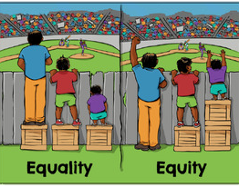
What is ‘fairness’?
Fair ≠ Equal
‘Fairness’ does not mean that every child has exactly the same, and we need to help children understand this.
For example...
Children who struggle with their learning will receive more support with learning.
Children who capture the hearts and minds of their peers will be selected for key roles such as House Captains if through voting.
Some opportunities are fair because they are open to all (inclusive/equality) e.g. Football club, but others may have criteria for selection. As long as we stick to the criteria, it is still ‘fair’ e.g. trials for football, selection on merit of behaviour or maths acumen .
Not all children will have the same amount of photos capturing school visits and events
Disappointment is a natural part of life – preparation for job interviews, unrequited love, etc. Acknowledge, reassure and help your child to move on!
See email communication from Mrs Lonie about selection for clubs,tournaments,etc.

Slide 44

Any Questions ?

