Slide 1
Welcome to Woodlands.
Your journey with us begins…….

Slide 2
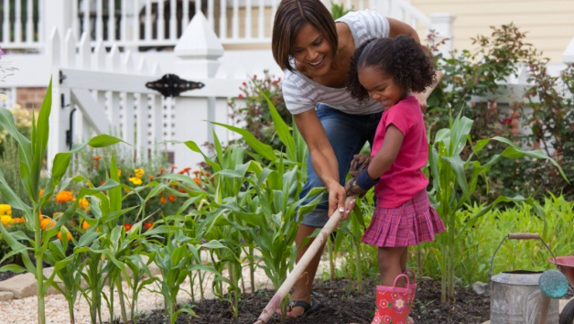
Things you need to know…
We are a healthy eating school so all drinks, snacks and lunches should follow this
Birthdays – children can wear their own clothes on their special day (no sweets/cake to give out though please)
We are a Smartphone Free school and actively discourage the early and over use of technology for young minds
We like our children to be active and outside so they will get mucky and they will get wet!
Notes:
NOTE: To change images on this slide, select a picture and delete it. Then click the Insert Picture icon in the placeholder to insert your own image.

Slide 3
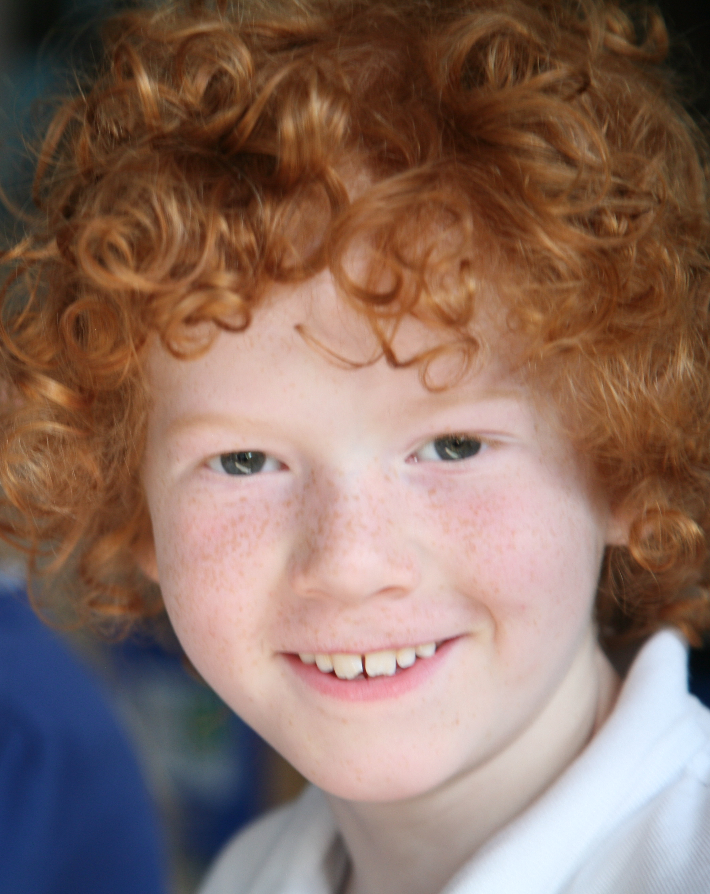
We highly recommend that parents read ‘The Anxious Generation’ by Jonathan Haidt.
He identifies three key reasons for the rise in adolescent anxiety and mental health issues: the ‘Great Rewiring of Childhood’ through:
smartphones and social media
the shift from play-based to phone-based childhoods
a disconnect between offline overprotection and online vulnerability.
Notes:
NOTE: To change images on this slide, select a picture and delete it. Then click the Insert Picture icon in the placeholder to insert your own image.

Slide 4
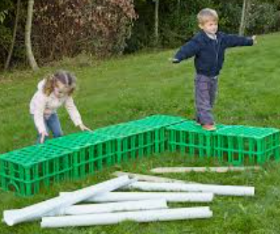
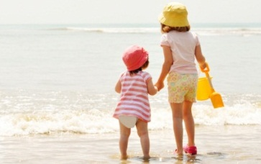

Risk is an important part of childhood and requires a balanced approach from parents…
Notes:
NOTE: To change images on this slide, select a picture and delete it. Then click the Insert Picture icon in the placeholder to insert your own image.

Slide 5
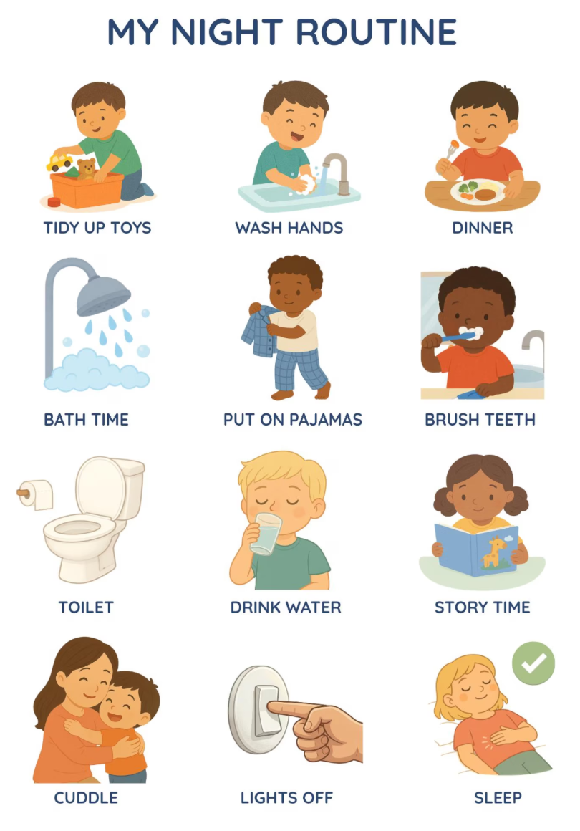
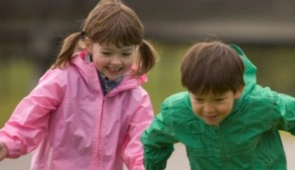


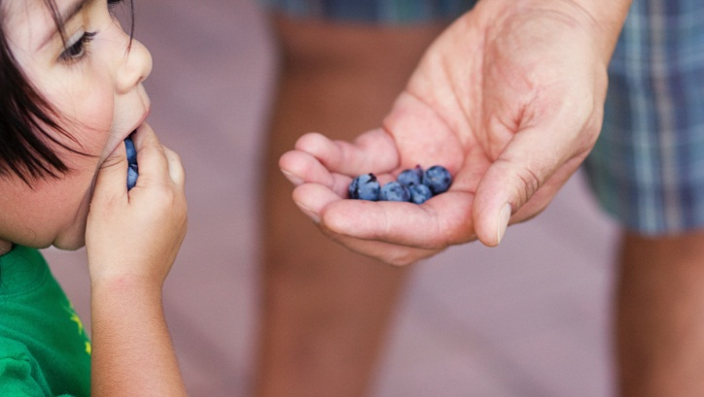
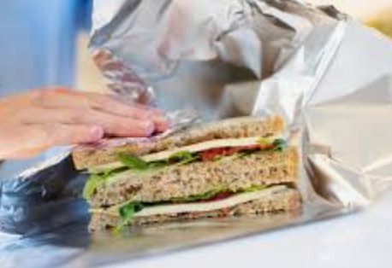
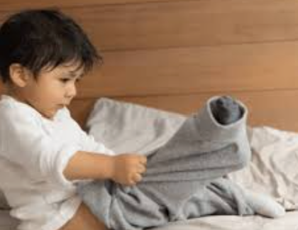
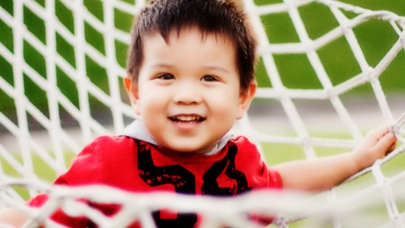

Building blocks of good childhood development….
Notes:
NOTE: To change images on this slide, select a picture and delete it. Then click the Insert Picture icon in the placeholder to insert your own image.

Slide 6

Drop and go as quickly as you can in the morning – don’t hang around and look through windows
Voice any worries you have out of earshot of your child and refrain from being negative about school/staff
Encourage your child rather than tell them what they can’t do
Encourage them to talk about their day in a positive way: ‘What was your favourite thing about today?’ rather than ‘Did ‘x’ do anything to you today?’
Don’t tell us to send your child home if they continue to feel poorly in front of them – they will want to come home!

Slide 7
Typical childhood experiences…
We’re not robots!
Your child will find challenges along the way:
Friendship issues
Unkindness
Difficulty telling the truth
Understanding we are all different
We can help them together!

Slide 8
We are experienced professionals so please treat us as such….trust us!

Slide 9
Typical responses at the end of the day….
I didn’t do anything or desire not to talk about their day
Extreme tiredness – we are very busy!
I didn’t play with anyone today.

Slide 10
Behaviour – recognition (rather than reward) and consequences (rather than punishment)….
Look at our behaviour policy for full details but the key elements are:
We set clear expectations
We develop excellent relationships with our pupils
We recognise good behaviour and when children go ‘over and above’ – house points, post cards, endeavour certificates, ambassador awards, ‘Out of this World’ points
We set clear consequences for poor choices – this includes ‘impositions’ and ‘detentions’ for older pupils
We are educators and therefore have to teach children (through restorative conversations) what good behaviour looks like and how to change behaviour over time
Neurodiversity is not a ‘get-out-of-jail-free’ card for poor behaviour but we do adapt for some pupils.
What is bullying? Please use the correct term to keep incidents in perspective.

Slide 11
Safeguarding
We will do all we can to help your child feel safe and happy, but we are a school and things do happen. Not every incident is a ‘serious safeguarding concern’ but we do take all incidents seriously.
We record behaviour and safeguarding concerns every day. They are sent to SLT to review.
We have a duty of care to staff and children. If your child makes a disclosure – we always take it seriously – but we also know it may not be true. We will ask you about anything that concerns us. Please understand we are asking because that is our job. We may need to make a referral to Social Services. This is for support.

Slide 12
Trip and swimming contributions
We plan trips to enhance children’s experiences and we take children swimming in Years 3 and 5. We ask for parental contributions towards these as we are not funded for them. Please plan ahead.
Clubs
Children will have opportunities to attend clubs run by staff and outsiders. There are more as the children go through the school. Not every child will get a place. They are a bonus not an expectation. They are not designed to be free childcare. We have Rainbows for after-school provision.

Slide 13
See email from Mrs Lonie about selection for clubs, tournaments,etc.
‘Fairness’ does not mean that every child has the exactly the same and we need to help children to understand this.
Examples:
Children who struggle to learn will receive more support with learning.
Children who capture the hearts and minds of their peers will be selected for key roles such as house captains if through voting.
Some opportunities are fair because they are open to all (inclusive/equality) e.g. football club, but others may have criteria for selection. As long as we stick to the criteria, it is still ‘fair’ e.g. trials for football, or selected on merit of behaviour or maths acumen .
Not all children will have the same amount of photos capturing school visits and events
Disappointment is a natural part of life – preparation for job interviews, unrequited love, etc. Acknowledge, reassure and help your child to move on!

Slide 14
Communication
See our page on the website under ‘Parents’. Tell us of any concerns before they become a big worry but also trust that we have your child’s best interests at heart.
Any questions?

